Slide 1
2023 R3 Release Webinar
All Things Web

Slide 2

Telerik UI .NET Web
UI for ASP.NET AJAX
UI for ASP.NET MVC/Core
UI for Blazor
.NET 8RC Support
ThemeBuilder

Slide 3
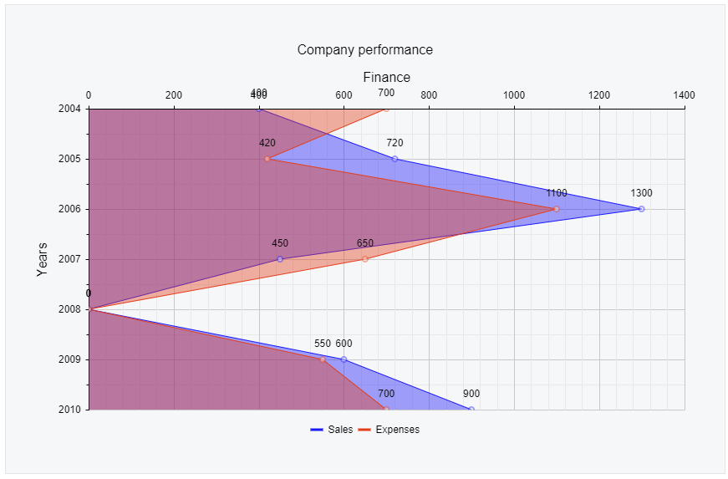
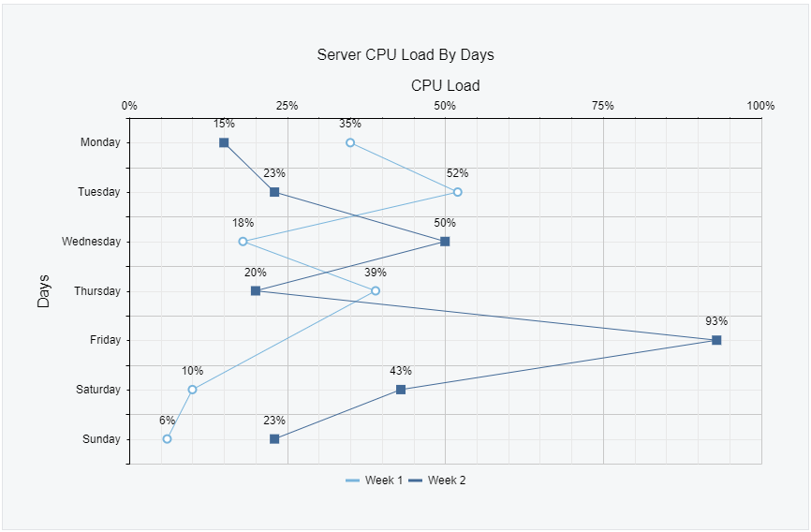
Telerik UI for ASP.NET AJAX
Avatar
Vertical Area Chart
Vertical Line Chart
Chart Improvements
Customizing the Label Position, Label Background, Step Property and more
Notes:
New component: Avatar
New Chart series: Vertical Area and Vertical Line charts
RadHtmlCharts enhancements: Customizing the Label Position, Label Background, Step Property and more
New Document Processing Libraries (DPL) features

Slide 4
End of .NET 3.5-4.0 Support After R2 2023 SP1 Newer Versions .NET 4.5-4.8 Only

Slide 5
Telerik UI for AJAX Demos

Slide 6

Day-Zero Support for .NET 8 Previews
.NET 8 RC2
Released in October
.NET 8 brings substantial performance improvements in Blazor
We will continue to support .NET 7 and 8 in cadence with MS

Slide 7

Content Security Policy Support
Using a strict CSP prevents hackers from using HTML injection flaws to force the browser to execute a malicious script
This policy is especially effective against cross-site scripting attacks
Strict compliance in R3

Slide 8
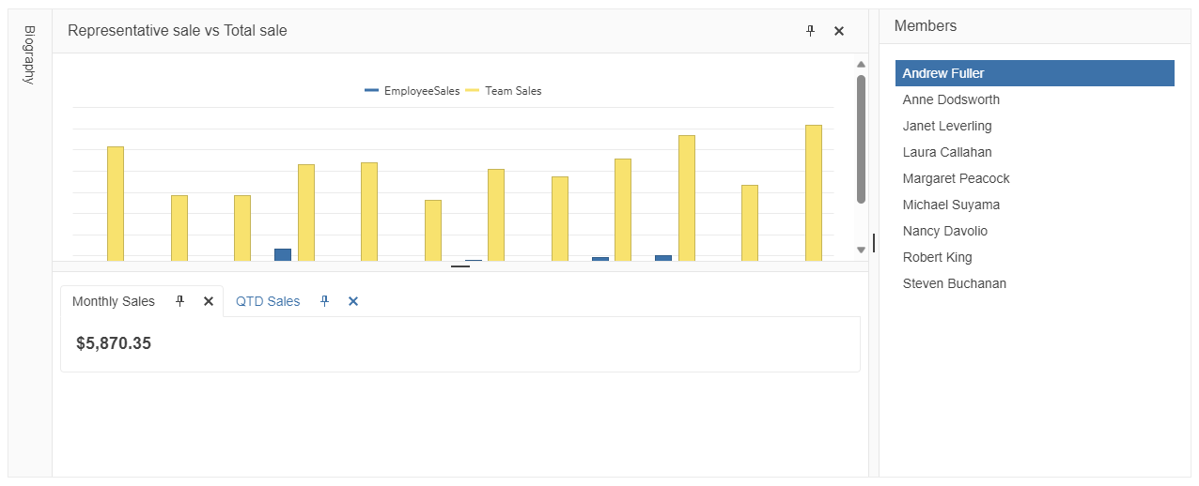
New in Telerik UI for MVC/Core
DockManger
Notes:
New DockManager UI component
New Chart series: Trendline and Pyramid charts
Powerful customizations across components: Scheduler Custom Toolbar, DatePicker Autofill, TabStrip Templates
PDFViewer enhancements: Improved PDFViewer scrolling, updated PDFViewer rendering based on latest designs​
Grid improvements: Dedicated Context Menu, improved Select or Multi-select on mobile devices with Touch Interactions, option to enable "Changing" Event
Strict CSP compliance
Accessibility improvements
New Document Processing Libraries (DPL) features

Slide 9
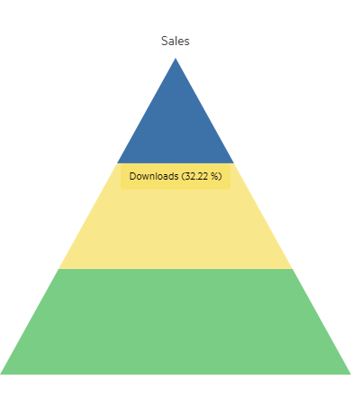
Telerik UI for MVC/Core
Pyramid Chart
Notes:
New DockManager UI component
New Chart series: Trendline and Pyramid charts
Powerful customizations across components: Scheduler Custom Toolbar, DatePicker Autofill, TabStrip Templates
PDFViewer enhancements: Improved PDFViewer scrolling, updated PDFViewer rendering based on latest designs​
Grid improvements: Dedicated Context Menu, improved Select or Multi-select on mobile devices with Touch Interactions, option to enable "Changing" Event
Strict CSP compliance
Accessibility improvements
New Document Processing Libraries (DPL) features

Slide 10
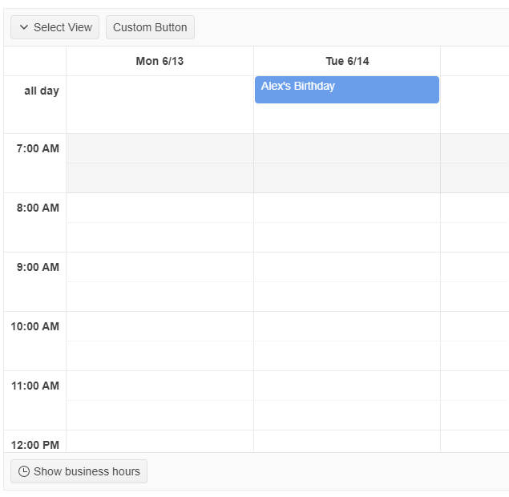
Telerik UI for MVC/Core
Customization Enhancements
Scheduler Custom Toolbar
DatePicker Adaptive Mode
TabStrip Templates
Notes:
New DockManager UI component
New Chart series: Trendline and Pyramid charts
Powerful customizations across components: Scheduler Custom Toolbar, DatePicker Autofill, TabStrip Templates
PDFViewer enhancements: Improved PDFViewer scrolling, updated PDFViewer rendering based on latest designs​
Grid improvements: Dedicated Context Menu, improved Select or Multi-select on mobile devices with Touch Interactions, option to enable "Changing" Event
Strict CSP compliance
Accessibility improvements
New Document Processing Libraries (DPL) features

Slide 11
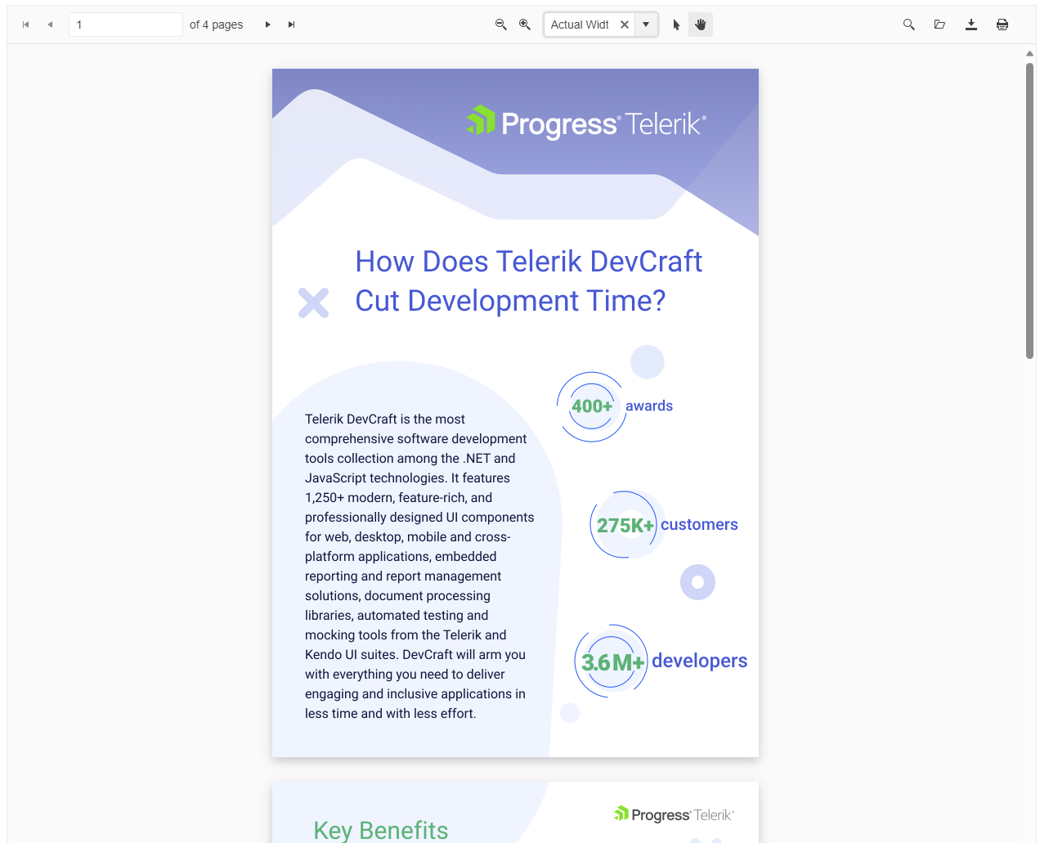
Telerik UI for MVC/Core
PDFViewer enhancements
Improved PDFViewer scrolling
Updated PDFViewer rendering based on latest designs​
Notes:
New DockManager UI component
New Chart series: Trendline and Pyramid charts
Powerful customizations across components: Scheduler Custom Toolbar, DatePicker Autofill, TabStrip Templates
PDFViewer enhancements: Improved PDFViewer scrolling, updated PDFViewer rendering based on latest designs​
Grid improvements: Dedicated Context Menu, improved Select or Multi-select on mobile devices with Touch Interactions, option to enable "Changing" Event
Strict CSP compliance
Accessibility improvements
New Document Processing Libraries (DPL) features

Slide 12
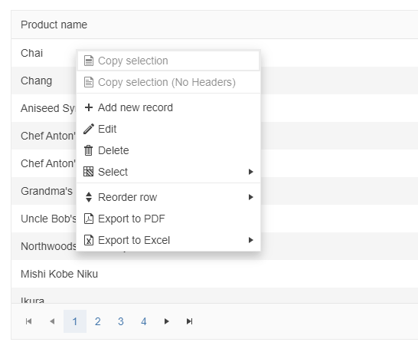
Telerik UI for MVC/Core
Grid improvements
Dedicated Context Menu
Improved Select or Multi-select on mobile devices with Touch Interactions
Option to enable "Changing" Event
Notes:
New DockManager UI component
New Chart series: Trendline and Pyramid charts
Powerful customizations across components: Scheduler Custom Toolbar, DatePicker Autofill, TabStrip Templates
PDFViewer enhancements: Improved PDFViewer scrolling, updated PDFViewer rendering based on latest designs​
Grid improvements: Dedicated Context Menu, improved Select or Multi-select on mobile devices with Touch Interactions, option to enable "Changing" Event
Strict CSP compliance
Accessibility improvements
New Document Processing Libraries (DPL) features

Slide 13
Telerik UI for MVC/Core Demos
Notes:
Scheduler - Integration example with Google Calendar
Adaptive Behavior Resources

Slide 14
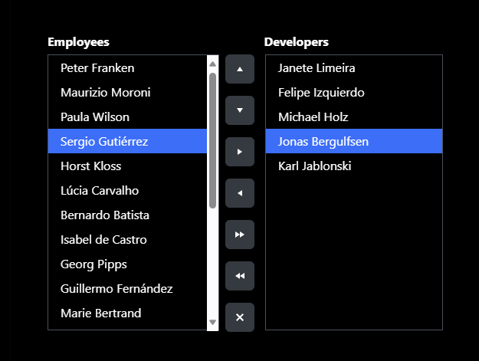
Telerik UI for Blazor
ListBox
Notes:
New components: ListBox, DropDownButton
New Chart series: Trendline, RangeArea, RangeBar, RangeColumn and Waterfall charts
Multiple Chart enhancements: Pan and Zoom, DrillDown support
PivotGrid improvements: Width of Column and Row headers, HeaderClass / Title of Column, Row, and Headers
Enhanced Gantt Popup Edit Form
Compatibility with .NET 8 RC2
Strict CSP compliance
Accessibility improvements
New Document Processing Libraries (DPL) features

Slide 15
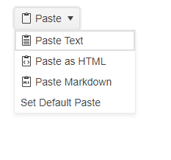
Telerik UI for Blazor
DropDownButton
Notes:
New components: ListBox, DropDownButton
New Chart series: Trendline, RangeArea, RangeBar, RangeColumn and Waterfall charts
Multiple Chart enhancements: Pan and Zoom, DrillDown support
PivotGrid improvements: Width of Column and Row headers, HeaderClass / Title of Column, Row, and Headers
Enhanced Gantt Popup Edit Form
Compatibility with .NET 8 RC2
Strict CSP compliance
Accessibility improvements
New Document Processing Libraries (DPL) features

Slide 16
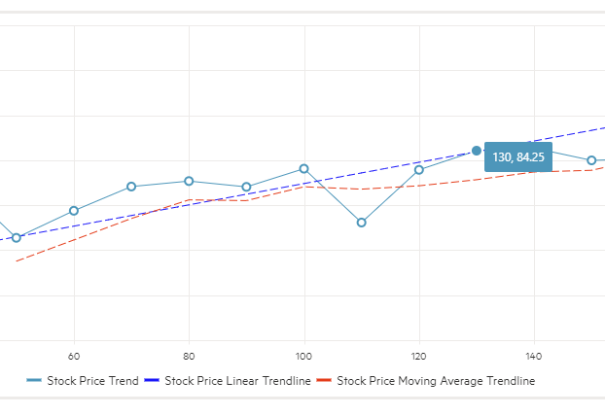
Telerik UI for Blazor
Trendline
RangeArea
RangeBar
RangeColumn
Waterfall charts
Notes:
New components: ListBox, DropDownButton
New Chart series: Trendline, RangeArea, RangeBar, RangeColumn and Waterfall charts
Multiple Chart enhancements: Pan and Zoom, DrillDown support
PivotGrid improvements: Width of Column and Row headers, HeaderClass / Title of Column, Row, and Headers
Enhanced Gantt Popup Edit Form
Compatibility with .NET 8 RC2
Strict CSP compliance
Accessibility improvements
New Document Processing Libraries (DPL) features

Slide 17
Deprecation of .NET 3 and .NET 5 in Telerik UI for Blazor Starting from R1 2024

Slide 18
Telerik UI for Blazor Demos

Slide 19
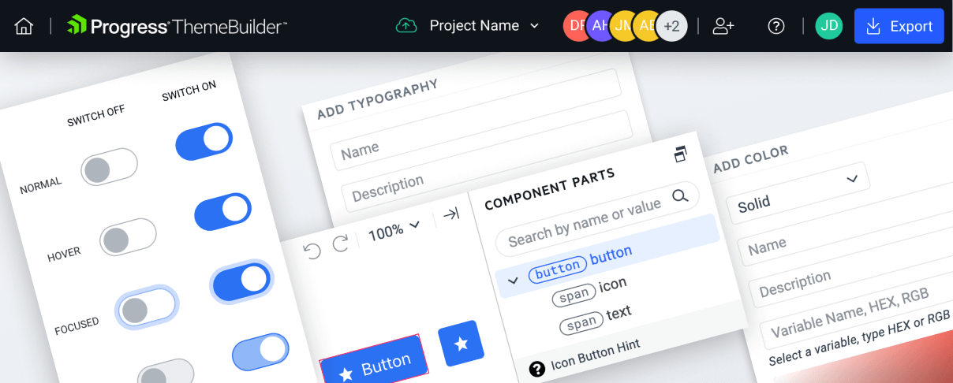
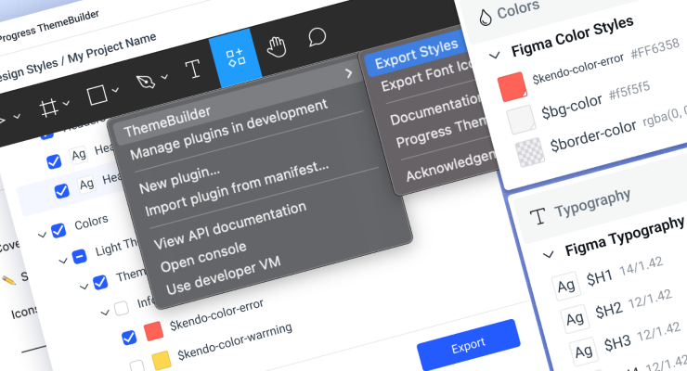

ThemeBuilder Enhancements ASP.NET MVC and ASP.NET Core

Slide 20
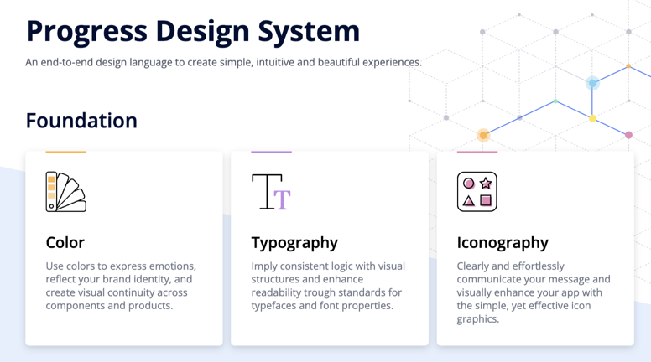
New Progress Design System Resources Telerik .NET and Kendo UI Web

Slide 21
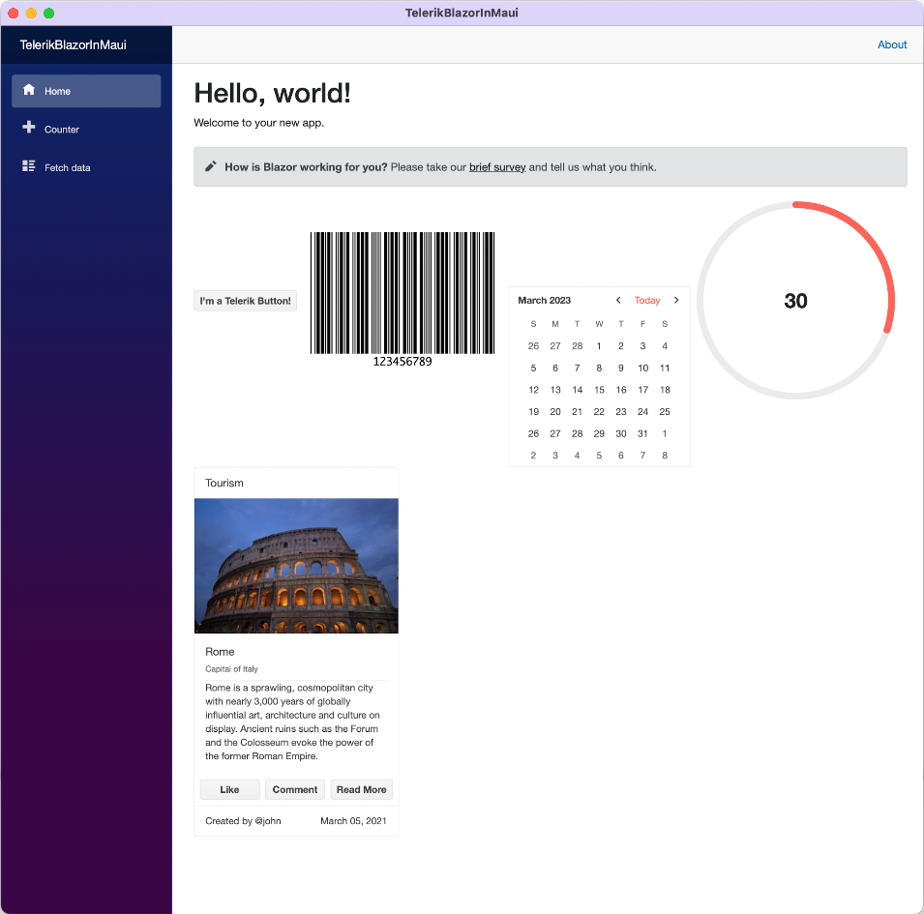
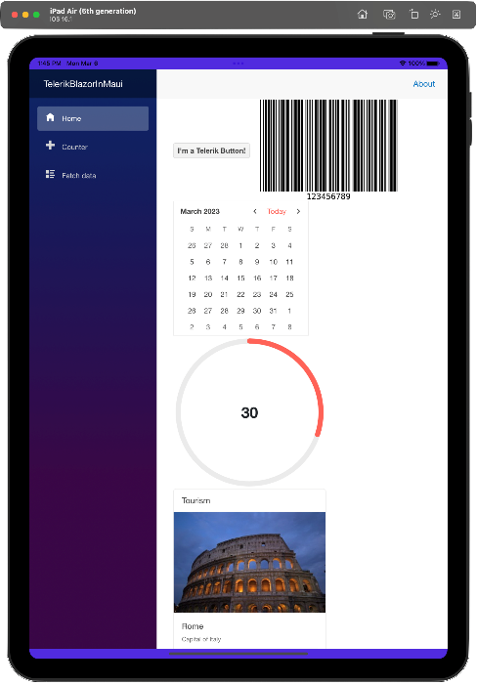
Blazor Hybrid is Officially Supported! Telerik UI for Blazor
.NET MAUI is the evolution of the MS .NET cross-platform strategy: a framework for creating native mobile and desktop apps with C#/XAML.
With support for Blazor Hybrid in Progress Telerik UI for Blazor, devs can leverage a common codebase between a Blazor web, desktop and mobile app and deploy across platforms faster – without the need to write additional code.

